Slide 1


Natural Sciences and Technology
Grade 6
Term 2: Matter and Materials
Solutions as special mixtures

Slide 2

Topic 3
Solutions as special mixtures
Insoluble substances
Gr 6 Natural Sciences and Technology – Term 2, Topic 3

Slide 3


Insoluble substances
Some solids will NOT form a solution in water – these are called insoluble substances.
Examples are:
Oil
Sand
Curry Powder
Gr 6 Natural Sciences and Technology – Term 2, Topic 3

Slide 4
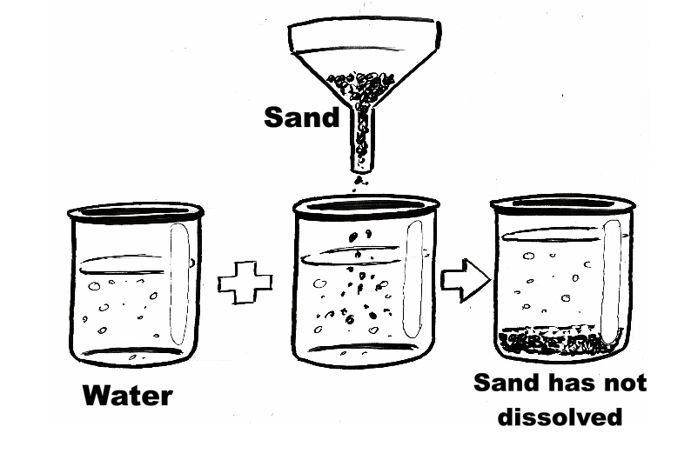
Insoluble substances
Gr 6 Natural Sciences and Technology – Term 2, Topic 3

Slide 5
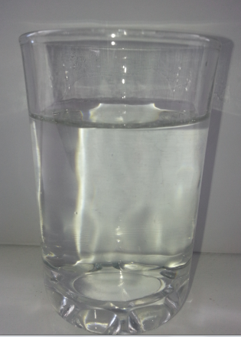
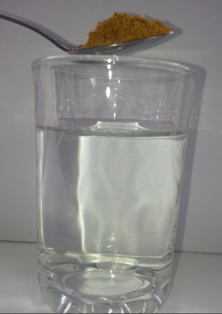
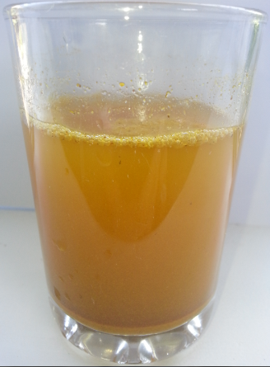
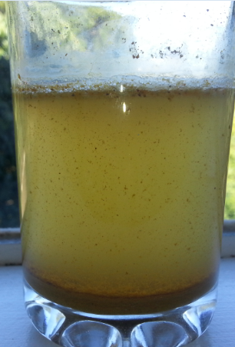
Insoluble substances
Curry powder settled at the bottom of the glass
Water in a glass
Curry powder to be added to the water
Curry powder mixed with water
Gr 6 Natural Sciences and Technology – Term 2, Topic 3
Notes:
Teacher explain that curry powder is not soluble in water. Show learners step by step what happens when curry powder is added to water.

