Slide 1
MATTER AND MATERIALS
Session 1
Gr 4 – 9 Topics | Material
Matter and Materials (and Processes) Particle model of matter Changes of state | Gr 6 | Solids, Liquids and Gases
 | Gr 7 | Physical Properties Boiling and Melting Points
 | Gr 8 | Particle model Solids, liquids and gases Changes of state

Slide 2
Things to talk about
What happens when we warm up ice?
Thinking about particles (like a chemist).
Bringing in the energy connection.
The wonderful water molecule.
Understanding physical and chemical change.
Do molecules change when states change?
What about bonds and intermolecular forces?
Link to concept map

Slide 3
Warm-up activity: Let’s pretend to be particles
9 – 12 participants are invited to the front where they must pretend to be the particles of:
A solid (vibrate but stay locked in place)
A liquid (move past each other but stay close)
A gas (scatter, occasionally bumping into each other and changing direction)
Use the activity as starting point for the discussion that follows.

Slide 4
What happens when we warm up ice?
(A discussion about changes of state)
We know that the ice (solid water) turns to liquid, which will turn to water vapour if we continue to heat it:
Ice → water → water vapour
SOLID → LIQUID → GAS
Each of these changes of state require the addition of energy.
In order to reverse each change of state we would need to remove energy.

Slide 5
Activity: Watch videos about changes of state and discuss their content
Videos:
C005 Particles solid liquid gas.wmv
States of Matter.wmv
How does a liquid become a gas.wmv
Questions to guide the discussion:
How can we link this to the particle model?
Refer to ‘Thinking like a chemist’ on the next slide.
How does adding energy “free” the particles during changes of state?
Discuss the forces between particles that are more easily overcome as the particles become more energetic.
What are the major differences between the 3 states of matter?
List them on paper, or verbally.

Slide 6
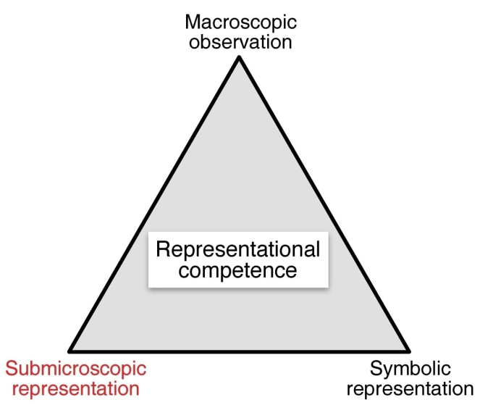
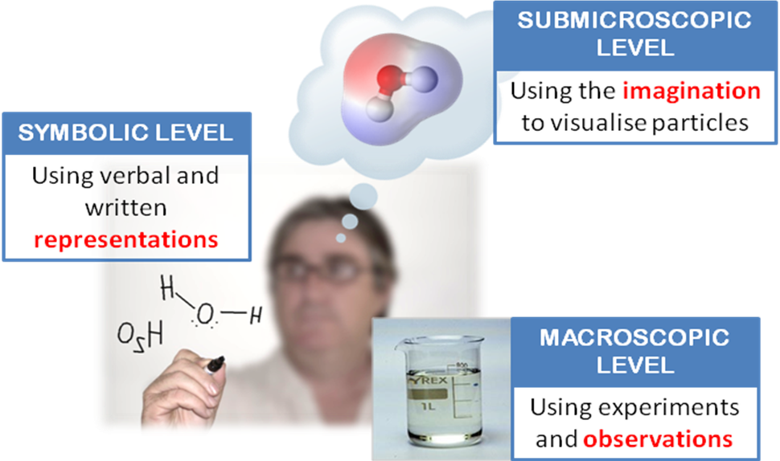
Thinking like a chemist
Chemists use 3 modes of representation when they engage with their subject.
Macroscopic or observable properties can be explained in terms of the submicroscopic structure of materials.
Learners must gradually develop the ability to imagine events that occur on the level of fundamental particles (atoms and molecules).
They must also develop the ability to converse about these events in the highly symbolic language of chemistry.

Slide 7
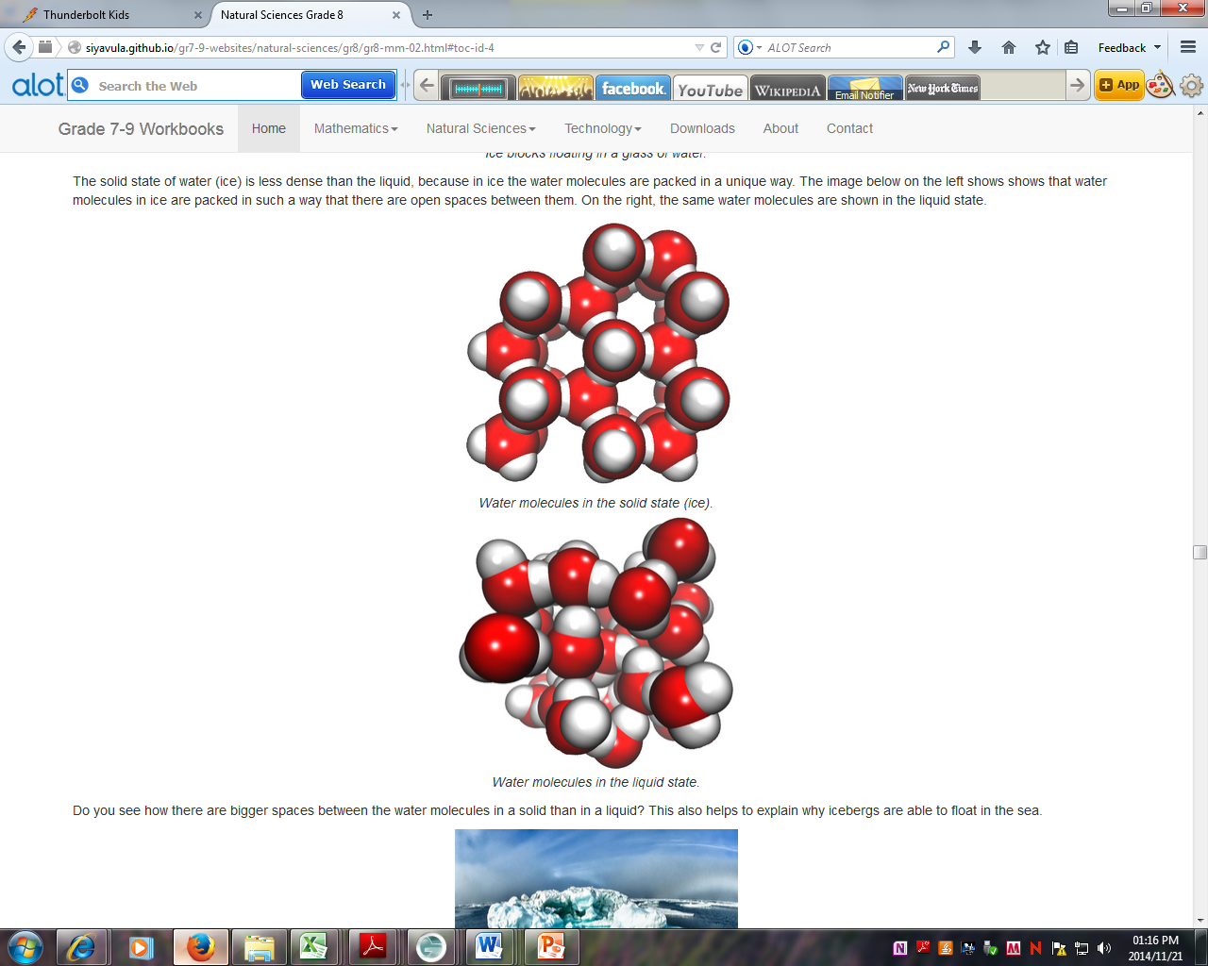
Activity: Let’s build a water molecule
Participants each build a water molecule using clay.
  (Specify the colours for the H and O atoms or you will get a range of interpretations.)
Participants join their water molecules to represent water in all three states.
Some diagrams to serve as guide:
Some questions to guide the discussion:
  Do the molecules change when states change?
  What is holding the water molecules together? (Discuss the difference between bonds and intermolecular forces)
  How can we link this with physical vs chemical change?

Slide 8
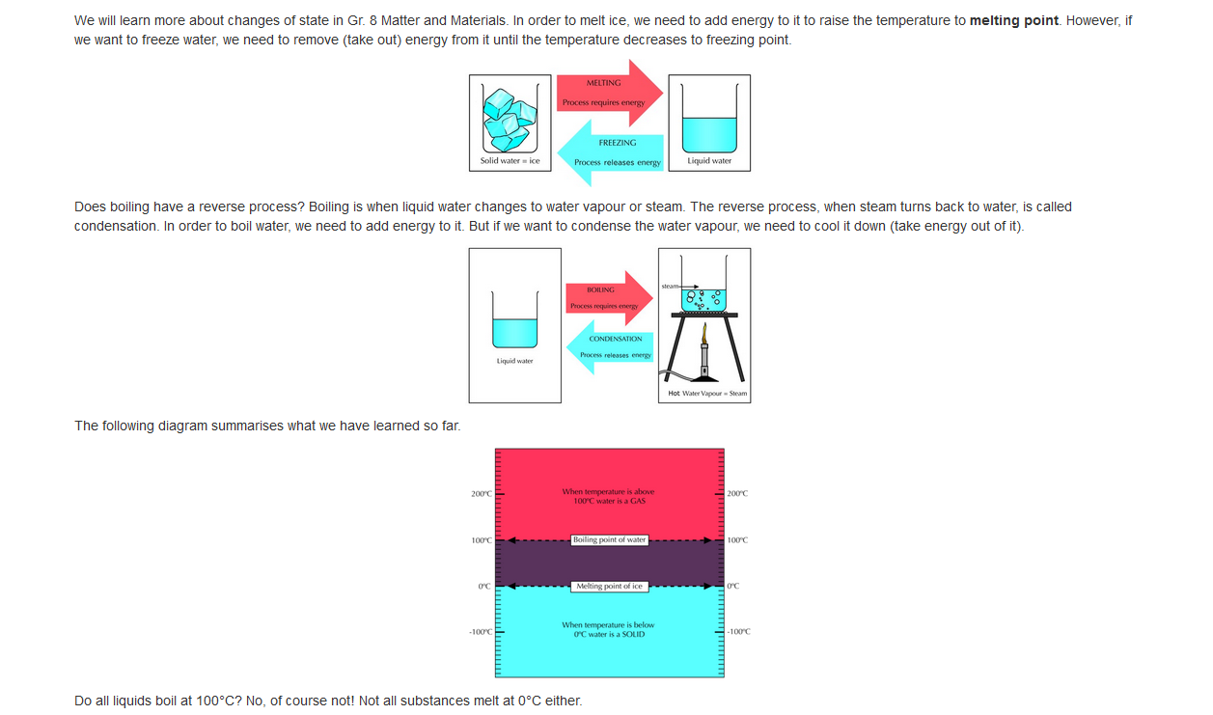
An excerpt from the workbook to discuss:
(Grade 7 M&M)

Slide 9
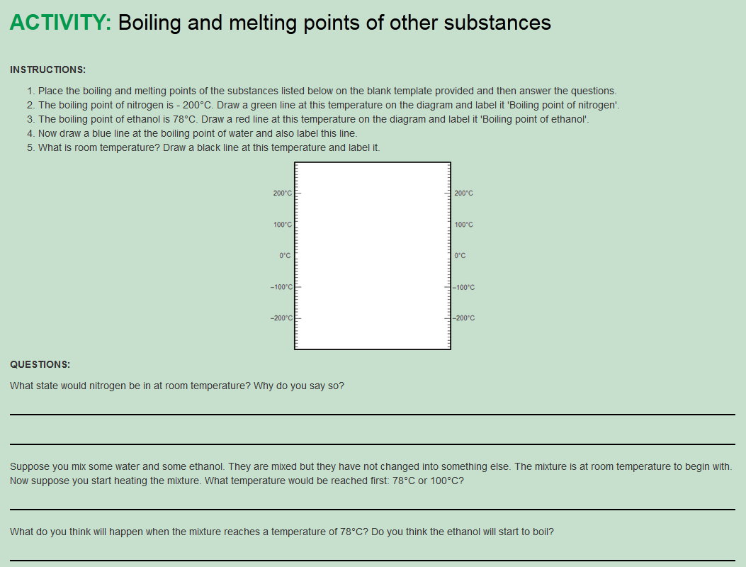
From Gr7 M&M

Slide 10
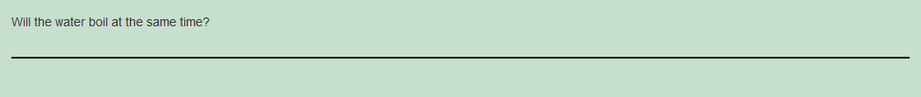
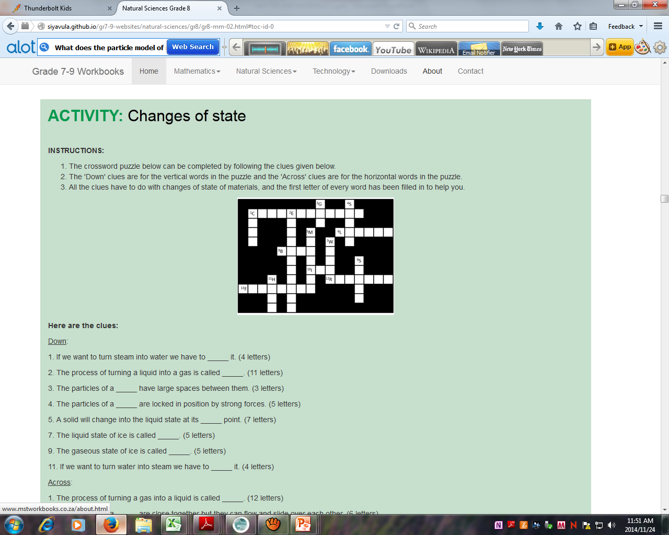

Slide 11
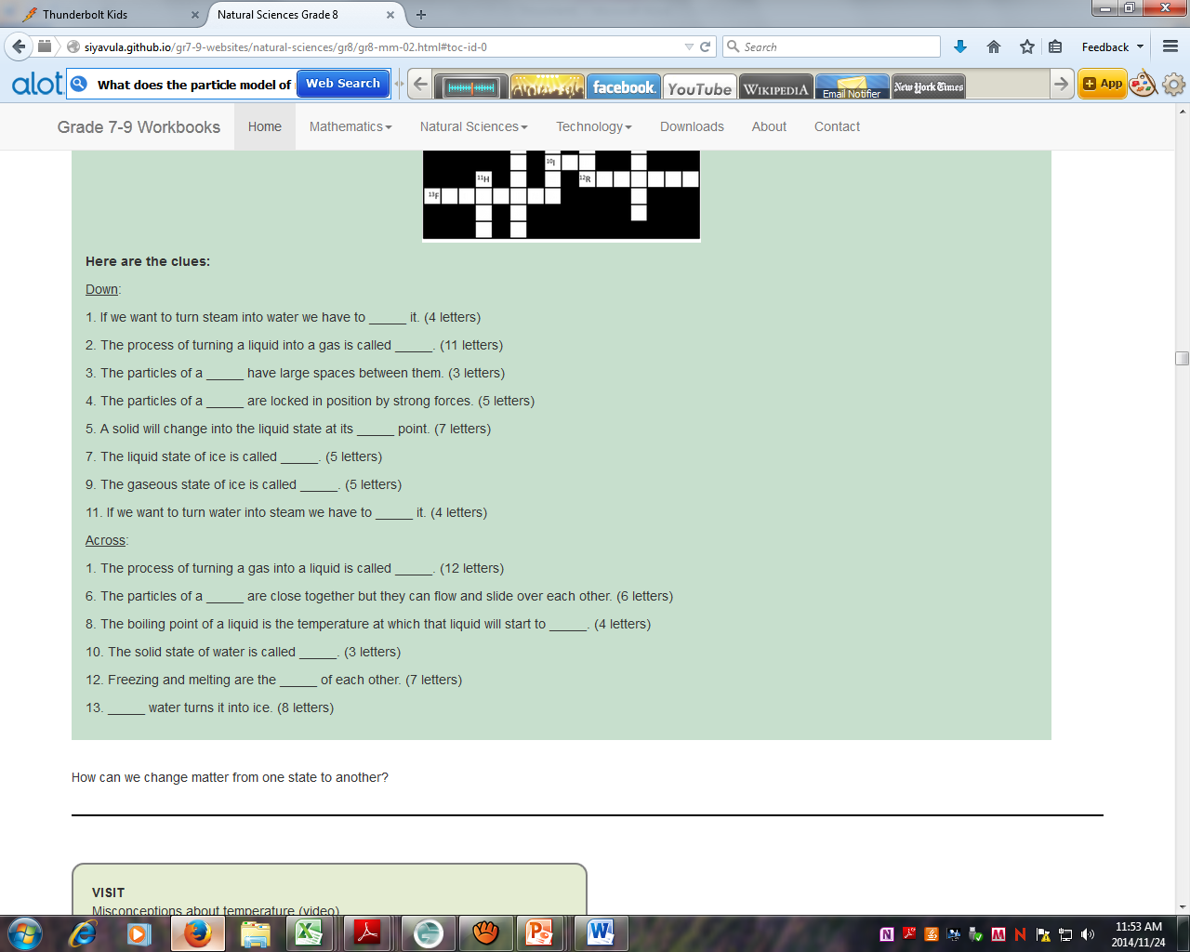
Additional demonstration: Imploding a cold drink can

Slide 12
MATTER AND MATERIALS
Session 2
Gr 4 – 9 Topics | Material
Matter and Materials (and Processes) Mixtures and solutions Introduction: Atoms | Gr 6 | Mixtures Solutions as specials mixtures, dissolving Water purification
 | Gr 7 | Separating mixtures
 | Gr 8 | Atoms Sub-atomic particles Mixtures and solutions

Slide 13
Things to talk about
What is a mixture?
When is a mixture also a solution?
Mixtures that contain water (or another solvent)
Terminology: Solute solvent solution
What happens when substances dissolve (and why do they dissolve?)
How can solutions be separated?
Building blocks of matter
What are the building blocks of these building blocks?

Slide 14
Activity: Watch videos about mixtures and discuss their content
Video:
The science of macaroni salad What’s in a mixture.wmv
Questions to guide the discussion:
What is a mixture?
What are the 3 types of mixtures, and how are they different?
What is a solution?
Two or more substances that are blended on the level of fundamental particles, i.e. atoms and molecules.
Do the chemical character of molecules change when they dissolve?
What types of solutions are there?
Gases dissolved in a gas (air)
Solids dissolved in a solid (stainless steel) and other examples.
What do we get when mixtures are separated?
How is separating mixtures different from breaking down molecules?
Physical vs chemical separation

Slide 15
Activity: Separating a mixture
Participants receive:
a mixture of beads of different materials, sizes, shapes and colours; and
Tools for separating the mixture such as tray, piece of textured carpet, sieve, plastic cup, magnet.
The facilitator will identify the high-value component.
Participants must work in groups to separate the high-value component from their mixtures.
Participants must represent their methodology in a flow diagram.

Slide 16
Video:
The science of macaroni salad What’s in a molecule.wmv
Questions to guide the discussion:
What is a molecule?
What do we have when we put a whole lot of molecules of the same type together?
How do the molecules of one compound differ from the molecules of another compound?
What do we end up with when we break down a molecule?
(Link to physical vs chemical separation)

Slide 17
Activity: Watch video about basic atomic structure and discuss its content
Video:
Basic Atomic Structure.wmv
Questions to guide the discussion:
What is an atom?
What do we have when we put a whole lot of atoms of the same type together?
How are the atoms of one element different from the atoms of another element?

Slide 18
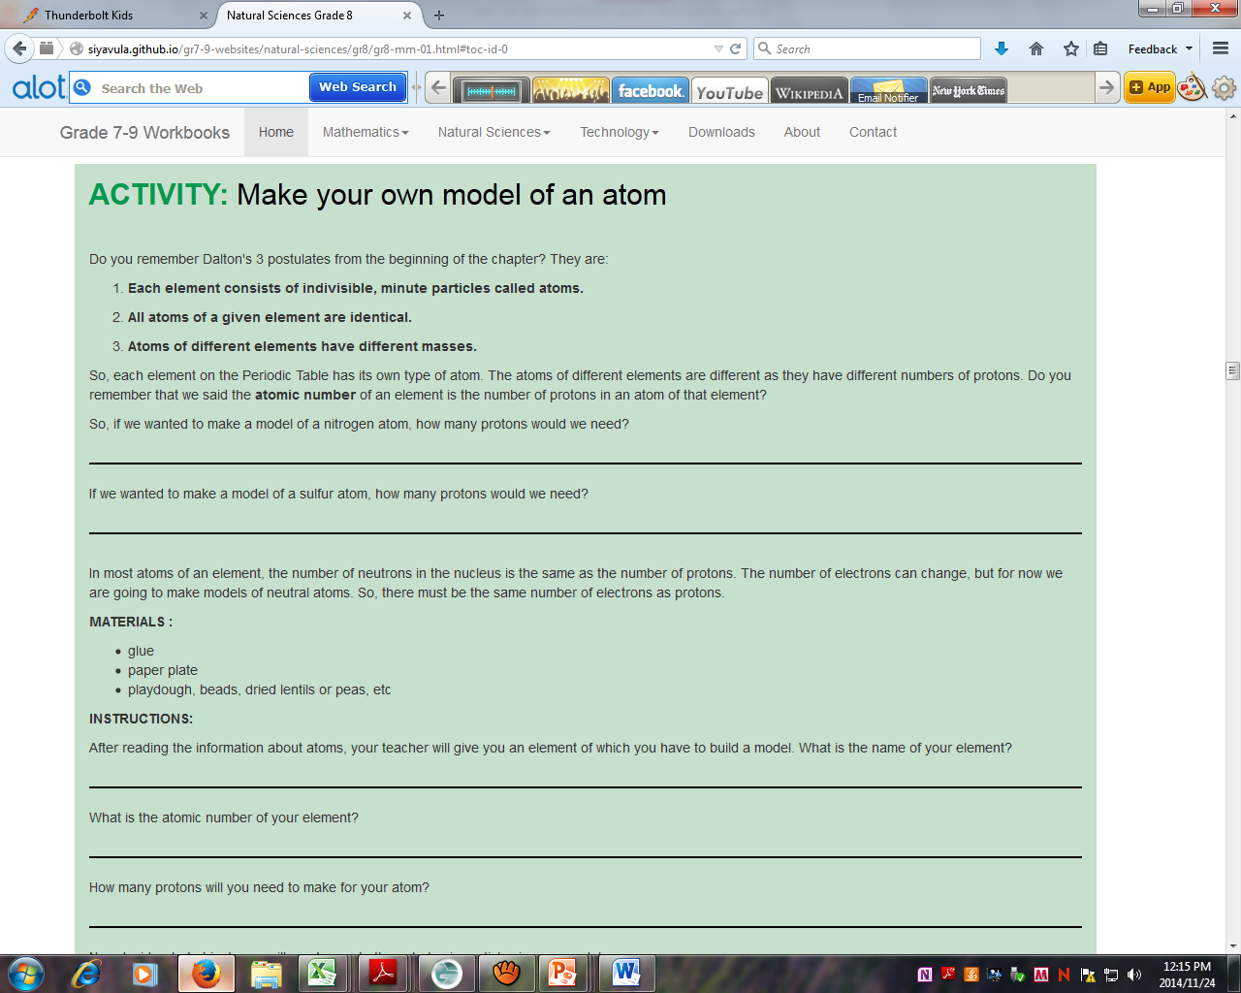

Slide 19
MATTER AND MATERIALS
Session 3
Gr 4 – 9 Topics | Material
Matter and Materials (and Processes) Elements and the periodic table | Gr 5 | Metals and Non-metals
 | Gr 7 | Arrangement of elements on the P T Symbols, atomic numbers
 | Gr 9 | Elements and compounds The P T Names of compounds

Slide 20
Things to talk about
So we have different kinds of atoms. Now what?
How do we distinguish between different kinds of atoms? (Names, symbols, atomic numbers, placement on the Periodic Table).
What is so special about the periodic table?
When all the atoms in a substance are of the same type.
When a substance has atoms of more than one type.
When we have to start putting elements together.

Slide 21
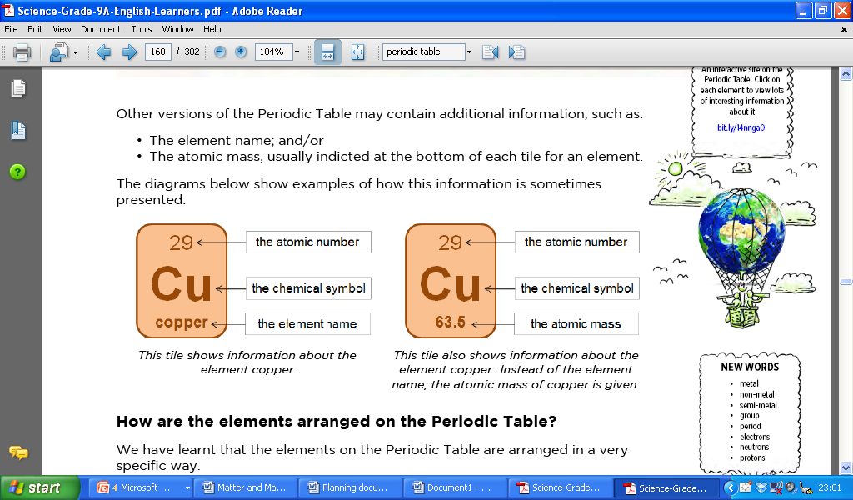
Discussion: How do we distinguish between different kinds of atoms?
Different systems for identification:
Name
Symbol
Atomic number
Placement on the Periodic Table

Slide 22
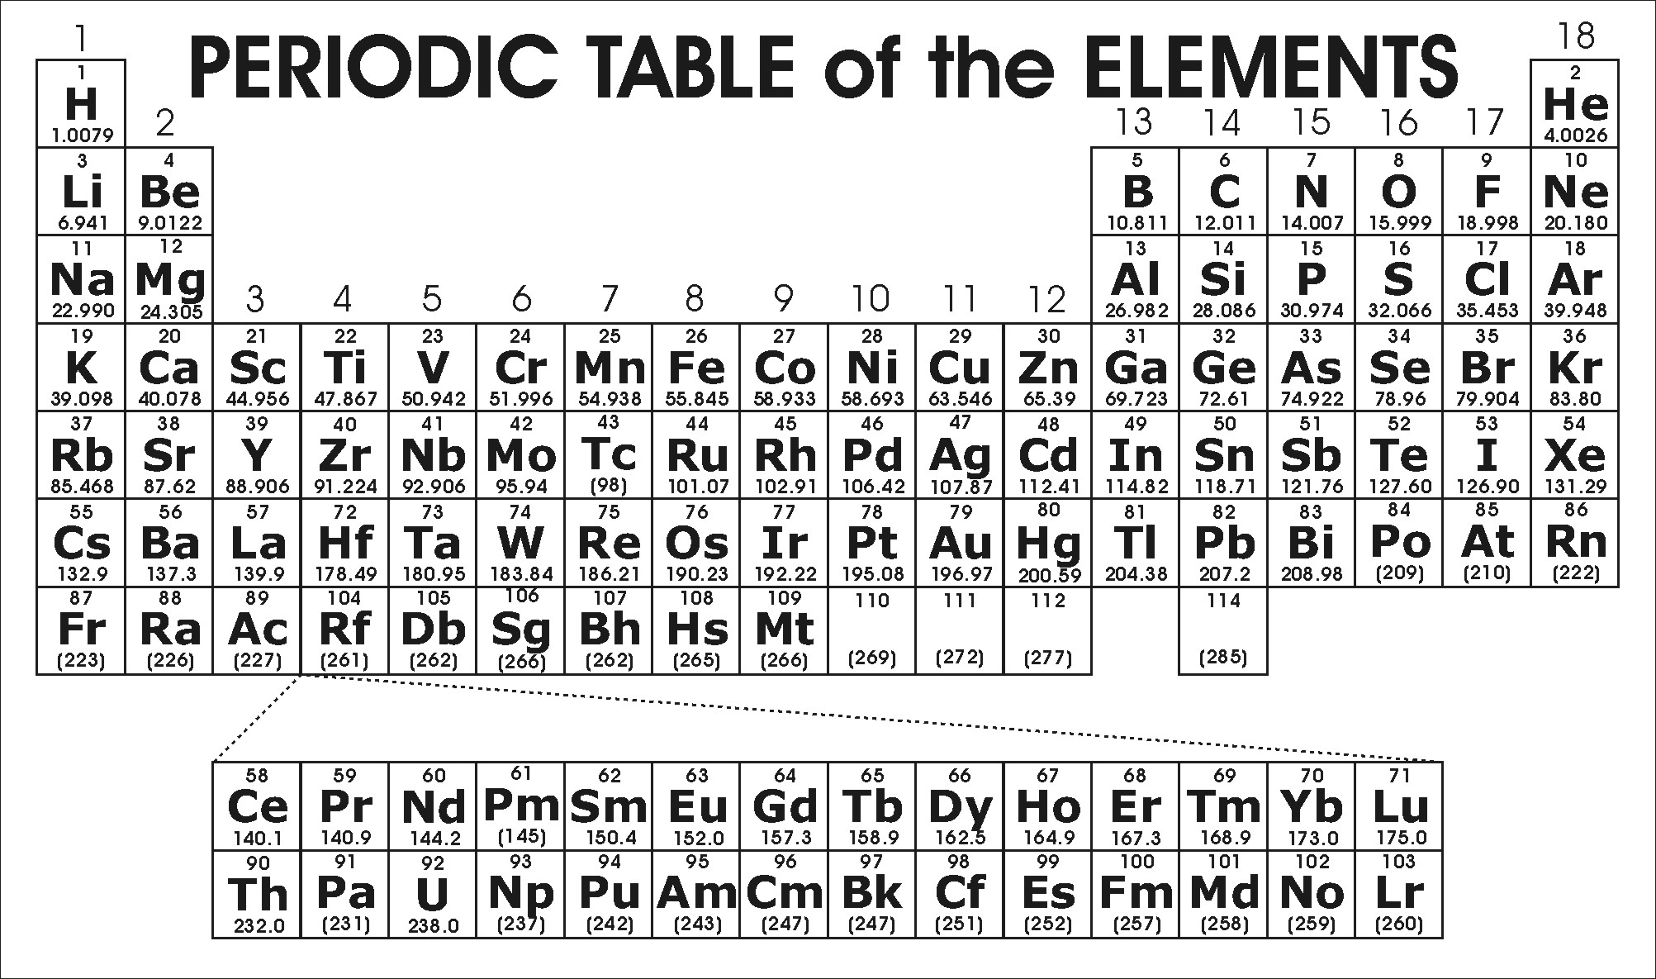
Discussion: What are the different regions on the periodic table?

Slide 23
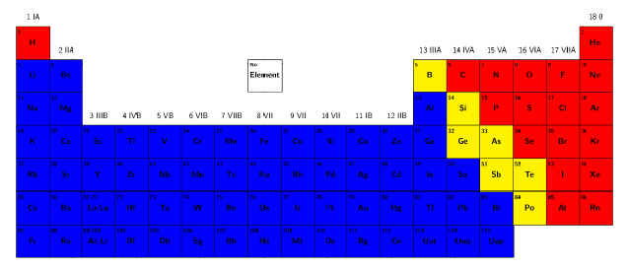
The blue area represents the metals.
  The alkali and alkaline-earth metals
  The industrial metals
  The noble matals
The red areas represent the non-metals.
The yellow area represents the semi-metals.

Slide 24
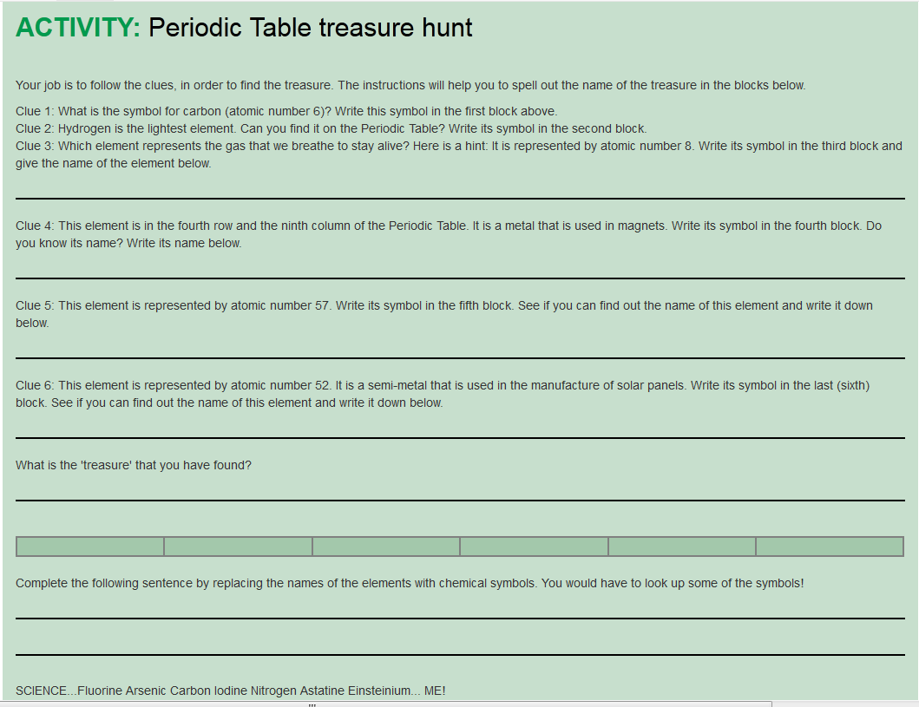

Slide 25
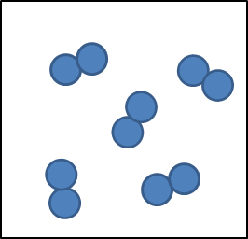
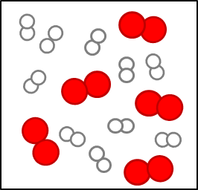
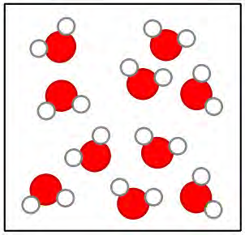
Discussion: When atoms combine
When all the atoms in a substance are of the same type, the substance is called an element.
When the molecules of a substance has atoms of more than one type, it is called a compound.

Slide 26
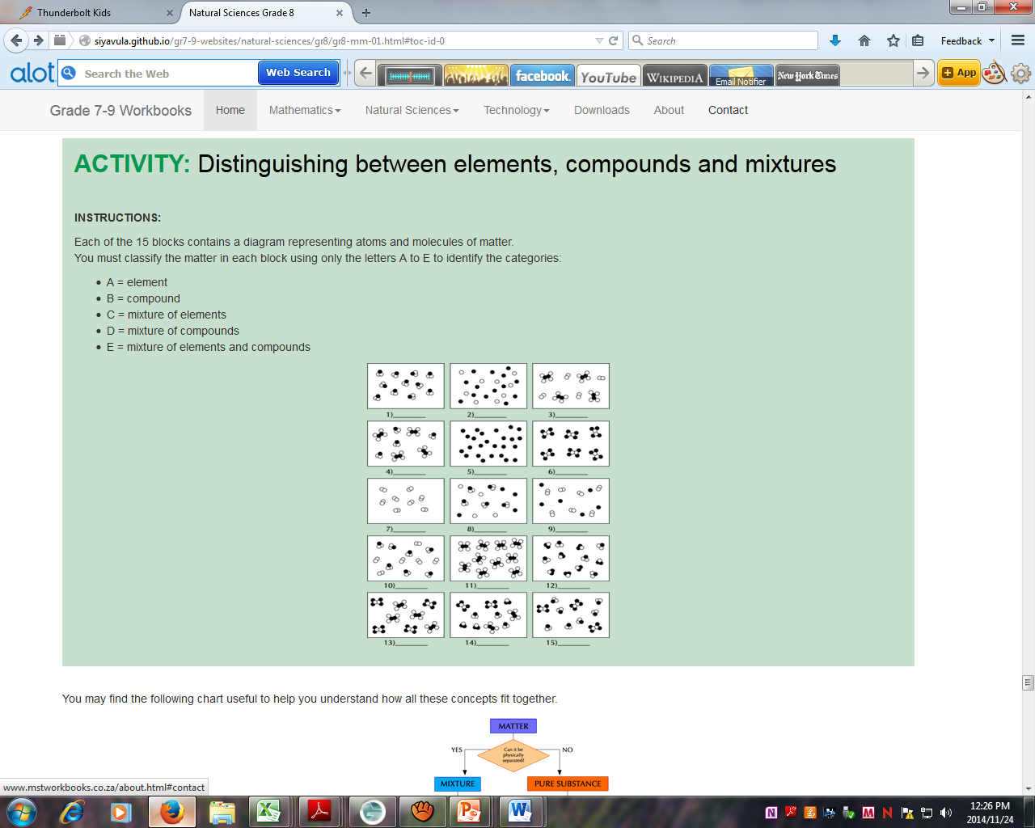

Slide 27
Discussion: How do we know how to combine the elements into compounds?
An element’s position on the periodic table helps predict how it will combine.
Discuss how we can use valency to predict the ratio in which atoms from opposite sides of the periodic table will combine.
Examples: MgO, NaCl, CaCl₂, etc.

Slide 28
MATTER AND MATERIALS
Session 4
Gr 4 – 9 Topics | Material
Matter and Materials (and Processes) Chemical reactions | Gr 9 | Chemical Reactions Metal + O₂ Non metal + O₂

Slide 29
Things to talk about
How can we make sense of it when substances react? (It all seems so random!)
Use the Periodic Table to help predict!
Get the products right before you try to balance.

Slide 30
Discussion: How do we make sense of chemical reactions?
The periodic table contains patterns to help us.
Valencies can sometimes help us predict the ratios in which atoms combine

Slide 31
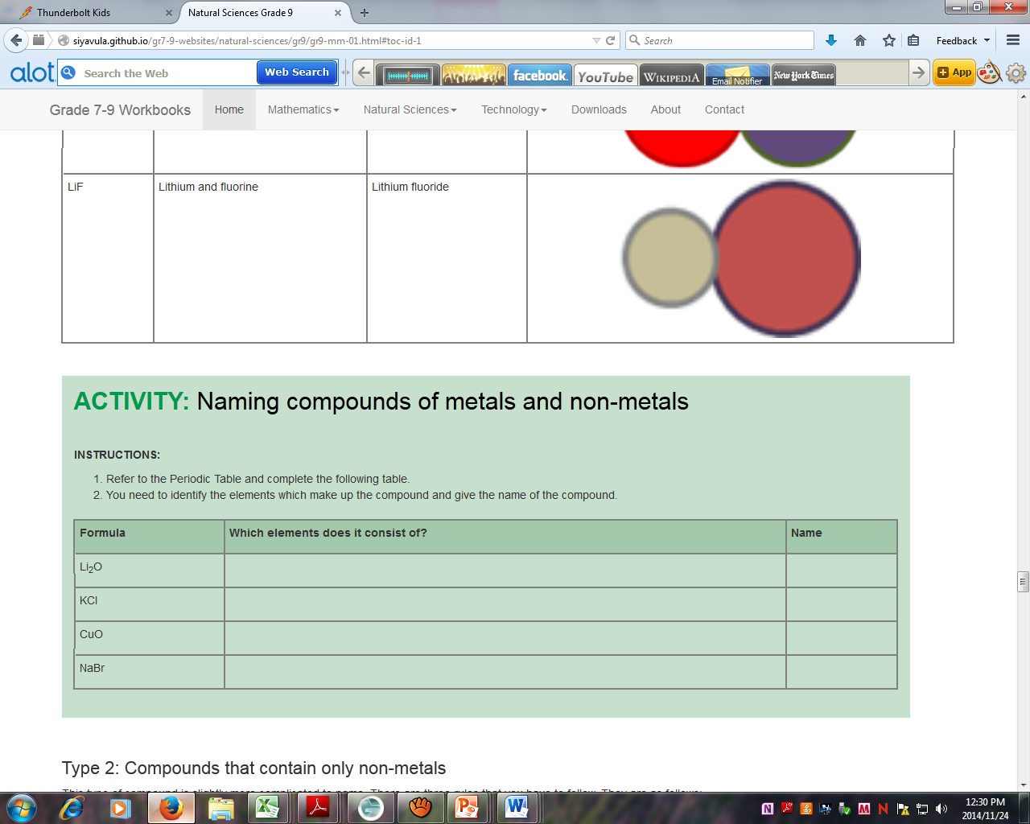
Discussion: Nomenclature of compounds
When to use prefixes (di-, tri- tetra- etc.) and when not to use them:
Metal + non-metal combinations do NOT use prefixes
Non-metal + non-metal combinations use prefixes

Slide 32
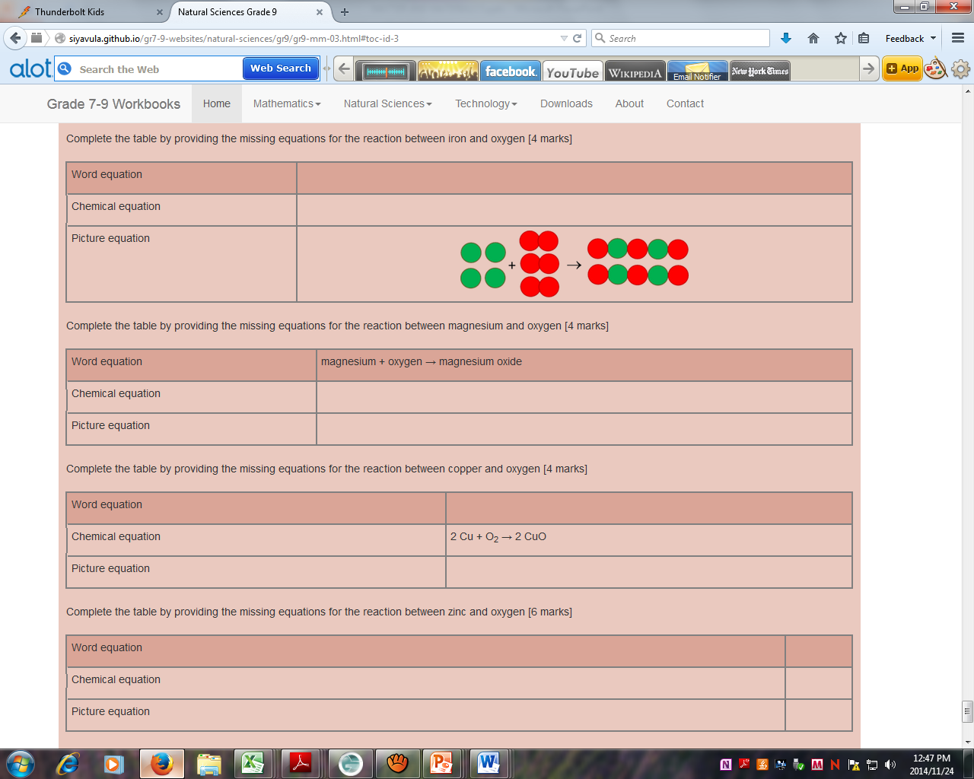
Activity: Reactions of metals with O₂

Slide 33
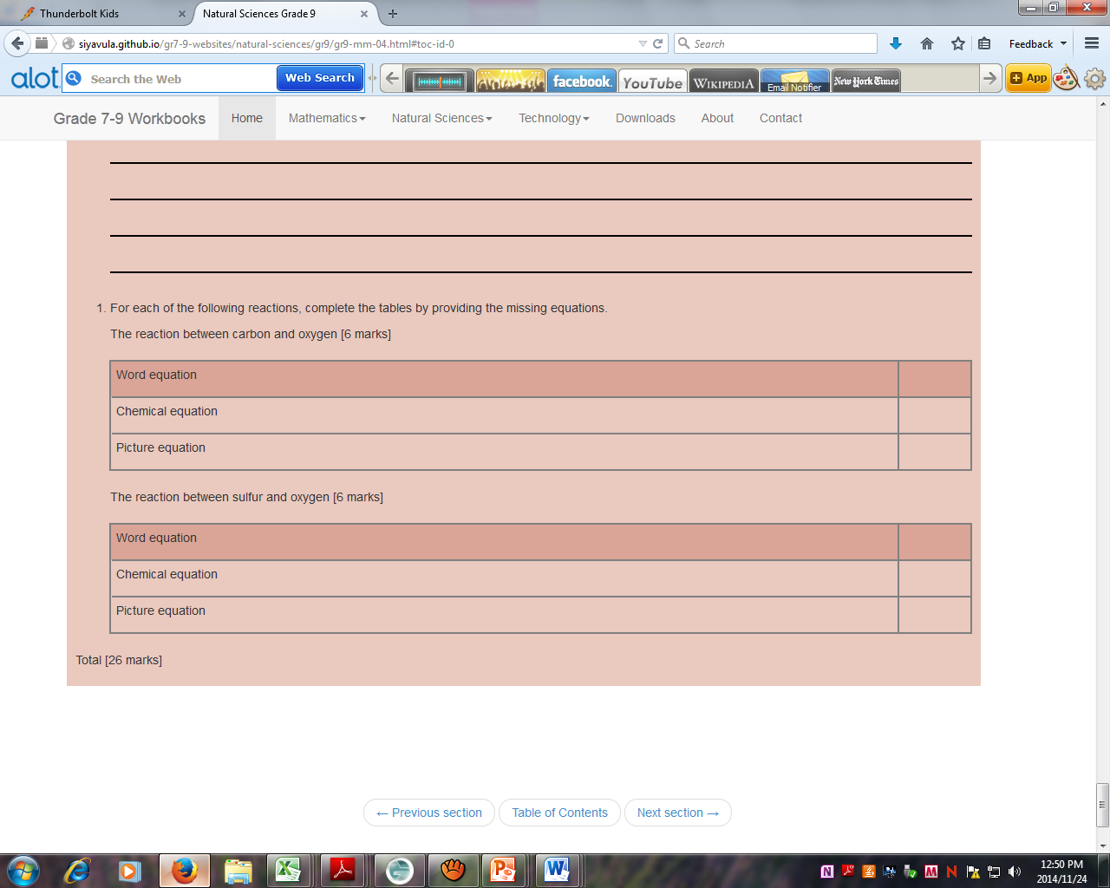
Activity: Reactions of non-metals with O₂

Slide 34
Activity: Watch two videos demonstrating how to balance equations.
Videos:
(Get from Rene Toerien)

Slide 35
MATTER AND MATERIALS
Session 5
Gr 4 – 9 Topics | Material
Matter and Materials (and Processes) Acids and bases Balancing chemical reactions | Gr 7 | Properties of acids and bases Indicators
 | Gr 9 | Acids and bases, pH, indicators Rxns of acids and bases Neutralisation Acid + MO Acid + MOH Acid + MCO₃ Acid + M

Slide 36
Things to talk about
What do we know about acids and bases?
Acids add H⁺
Bases remove H⁺ (sometimes by adding OH–)
How does an indicator work?
Neutralisation is H⁺ + OH– → H₂O
Now we apply this principle to a series of reactions…

Slide 37
Activity: What do we know about acids and bases?
Use a flipchart to write down participants’ ideas.
Address alternative conceptions such as:
Acids ‘contain’ H (or H⁺) (use NH₃ to refute)
Bases ‘contain’ OH (or OH–) (use Na₂CO₃ to refute)
Discuss how the Bronsted-Lowry model simplifies the issue by focusing on H⁺-exchange

Slide 38
Activity: Design an activity to illustrate how an indicator works
Use paper with two different colours on opposite sides of the sheet as the basis for an activity to illustrate the action of an indicator.

Slide 39
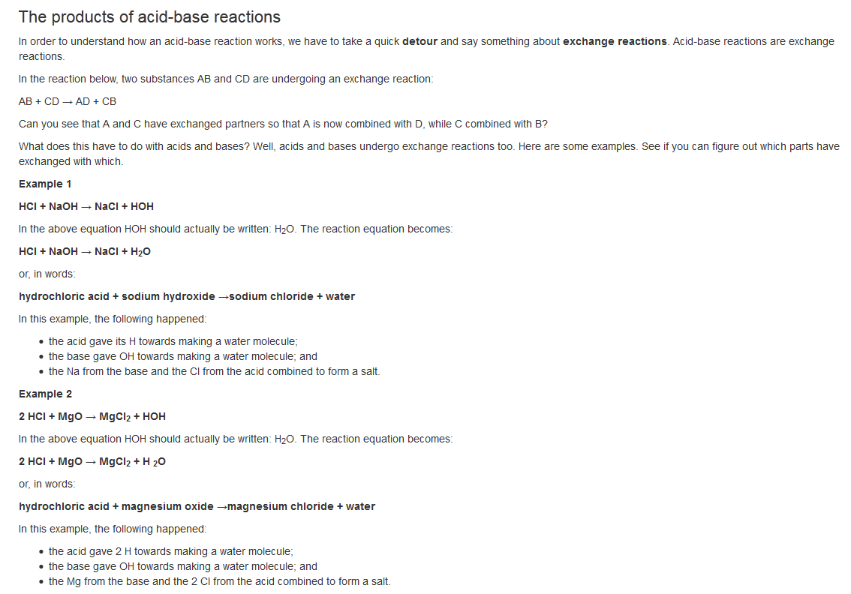
The reaction H⁺ + OH– → H₂O is the driving force behind acid-base reactions

Slide 40
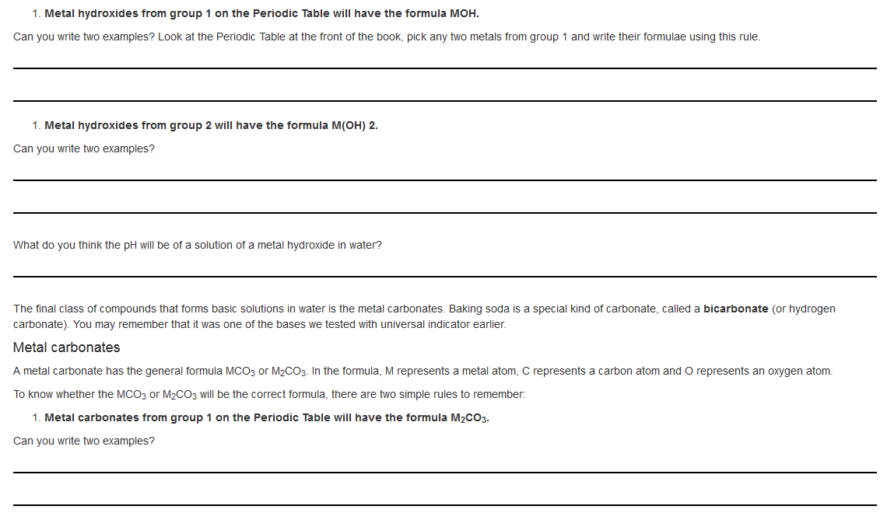
Activity: Some typical bases
The acids learners need to know are HCl, HNO₃ and H₂SO₄.
This activity introduces some typical bases.

Slide 41
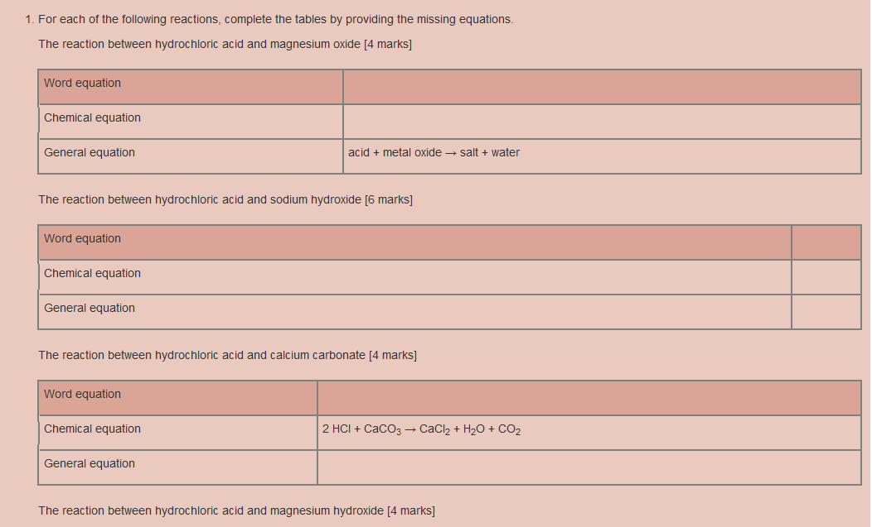
ACTIVITY: Reactions of acids and bases

Slide 42
